Slide 1
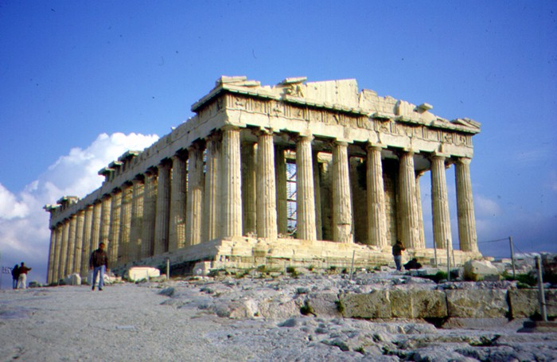
Architecture- Columns
Three types of column

Slide 2
Columns
A column was a huge post that holds a roof up.
The first columns were made of wood.
When ancient cultures ran out of wood they used rock instead of wood.

Slide 3
Marble
Marble is a kind of rock.
It comes in many colors and is beautiful.
There was a lot of marble in Greece.
Most of it was a creamy white color.
Many Grecian buildings are made of marble.

Slide 4
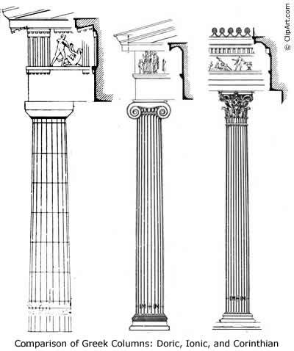
Schools of Architecture
There were three schools of Grecian architecture.
Doric
Ionic
Corinthian

Slide 5
Doric Columns
The top of the columns are a square block.
Under the block is a rounded piece.
The columns are thick.
The base is a square block.

Slide 6
Doric
This is a drawing of a Doric column.
Notice the square block at the top.
Notice the rounded piece under the block.
The column is thick.
The base is made of a square block.

Slide 7
Doric
This drawing shows how the Doric column was used.
The columns hold up the roof.
The roof line was very fancy.
The top of the column is called the capital.

Slide 8
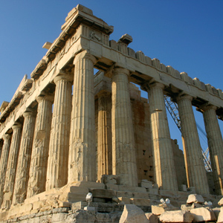
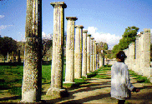
Doric Colonnade in Zeus’ Palace
Colonnade- a long sequence of columns

Slide 9
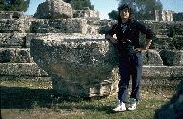
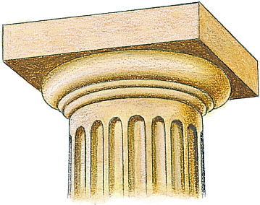
Doric capitals were very large.

Slide 10
Doric Columns in the Parthenon

Slide 11
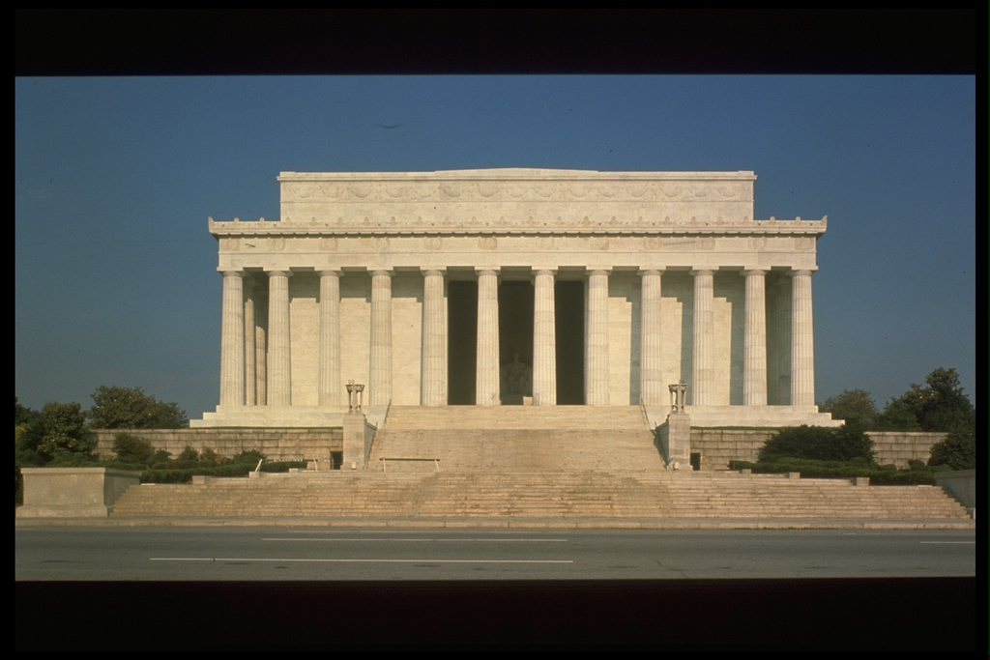
Doric Columns Today
The Lincoln Memorial in Washington, D.C.

Slide 12
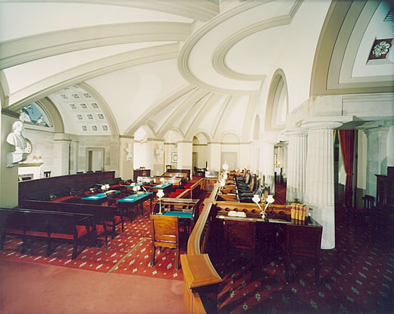
Doric Columns Today
Old Supreme Court Chamber

Slide 13
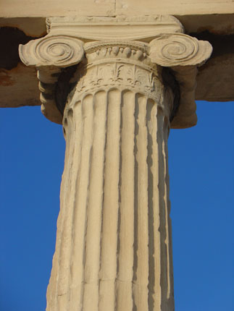
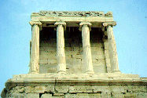
Ionic- Columns

Slide 14
Ionic Columns
The Ionic Column was invented next.
The Ionic capital looks like a scroll.
The Ionic column is skinnier.
The base has a rounded and a square section.

Slide 15
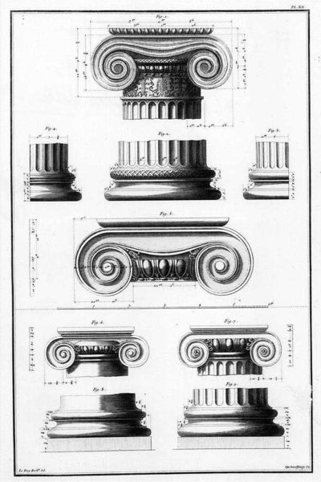
Ionic
Here are some drawings of an Ionic columns.
Notice the capital is shaped like a scroll.
Notice the column is skinnier.
This base is square.
Many times the bases were fancier.

Slide 16
Ionic
This drawing shows how the Ionic column was used.
The columns hold up the roof.
The roof line was very fancy.
The capital looks like a scroll.
The base is layered.

Slide 17
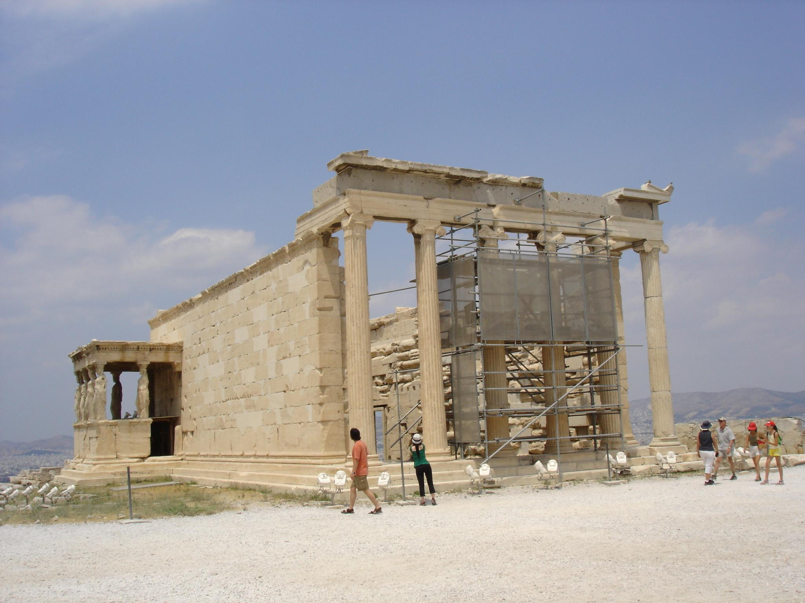
Ionic Columns at Athena’s Temple

Slide 18
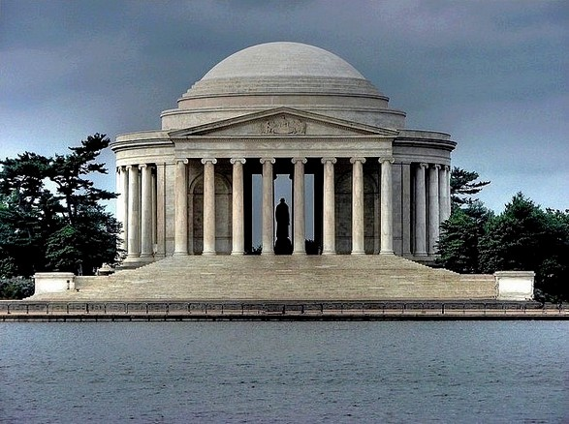
Ionic Columns Today
Thomas Jefferson National Memorial

Slide 19
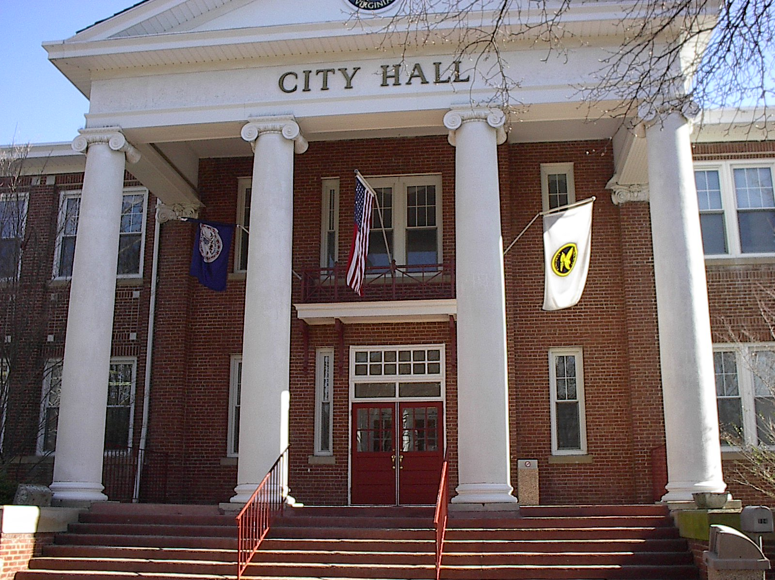
Ionic Columns Today
Salem City Hall

Slide 20
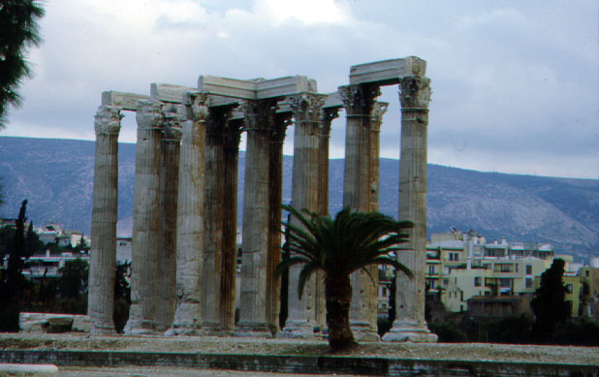
Corinthian

Slide 21
Corinthian Columns
Corinthian columns were the most decorative.
The capitals were carved to look like leaves.
The columns were the thinnest.

Slide 22
Corinthian Columns
This is a drawing of a Corinthian column.
Notice the capital looks like leaves and flowers.
The column is the thinnest of all.
The base is the fanciest of all.

Slide 23
Corinthian
This drawing shows how the column was used.
The column holds up the roof.
The roof line had lots of parts, but not so much carving.
The capital is very fancy and so is the base.

Slide 24
Corinthian Columns in Zeus’ Temple

Slide 25
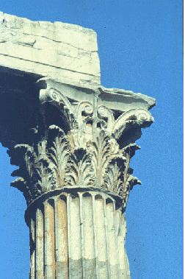
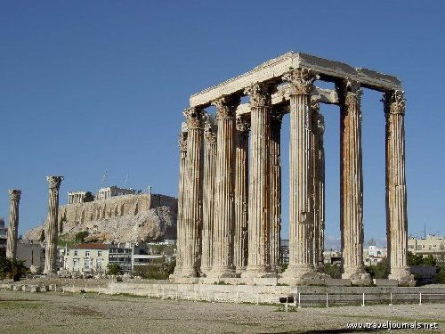
Corinthian Columns in the Olympian

Slide 26
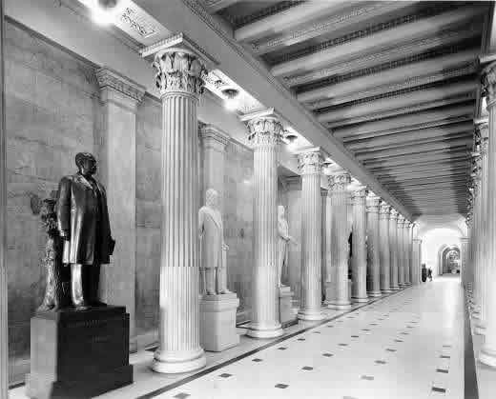
Corinthian Columns Today
Hall of Columns in the Capital Building

Slide 27
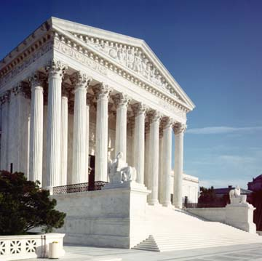
Corinthian Columns Today
United States Supreme Court Building

Slide 28
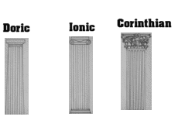
The Three Schools of Grecian Architecture

Slide 29
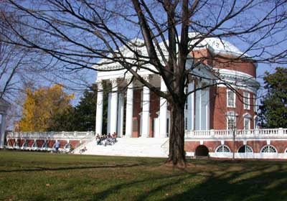
UVA Uses All Three Columns
Thomas Jefferson used Doric, Ionic and Corinthian columns to teach Grecian architecture.

